Slide 1
EXL Health AI Lab at MEDIQA-OE 2025
Evaluating Prompting Strategies with MedGemma for Medical Order Extraction

Slide 2
EXL Health AI Lab at MEDIQA-OE 2025
Evaluating Prompting Strategies with MedGemma for Medical Order Extraction

Slide 3
Motivation
The Problem
Doctors spend excessive time on clinical documentation
Critical need: Extract medical orders from conversations automatically
Challenge: Medications, labs, imaging, follow-ups require high accuracy
Real-world difficulty: Long conversations, interruptions, informal language
Goes beyond entity recognition → requires context, negation, relationships

Slide 4
Order Extraction Requirements
Dataset: SIMORD Sources: ACI-Bench + PriMock57
Order Type: The category of the order (e.g., Medication, Lab, Imaging, Follow-up)
Description: The specific details of the order (e.g., “Lisinopril 10mg daily”)
Reason: The clinical justification for the order (e.g., “for high blood pressure”).
Provenance:: Exact transcript portions containing relevant information.
Dataset | Encounters | Follow-up | Imaging | Lab | Medication | Total Orders
Train | 63 | 25 | 14 | 29 | 75 | 143
Dev | 100 | 41 | 26 | 71 | 117 | 255

Slide 5
Our Foundation: MedGemma
Model Selection
MedGemma: Google's Gemma models pre-trained and fine-tuned on medical literature
• Domain-specific tuning for medical terminology
• Strong baseline understanding of clinical concepts
• Open-source language model
limitations
MedGemma-4B
Smaller, faster variant
MedGemma-27B
Larger, more capable variant

Slide 6
Three Prompting Approaches
Agentic Workflow: Multi-agent pipeline with specialized roles: Identifier scans transcripts, Mapper pairs orders with reasons, Structurer formats JSON, Validator checks accuracy.
1-Shot Prompting: Direct approach with single high-quality example. Model receives conversation transcript and replicates structured JSON output format.
ReAct Framework: Reasoning and Acting paradigm with iterative cycles. Model thinks aloud through Thought-Action-Observation steps with validation constraints.

Slide 7
Approach 1: 1-Shot Prompting
Simplest and Most Direct
Method:
• Provide one high-quality example
• Append test transcript
• Model generates JSON in same format
Advantages:
• Clear and concise prompt
• Minimizes cognitive load
• Powerful in-context learning
• Computationally efficient

Slide 8
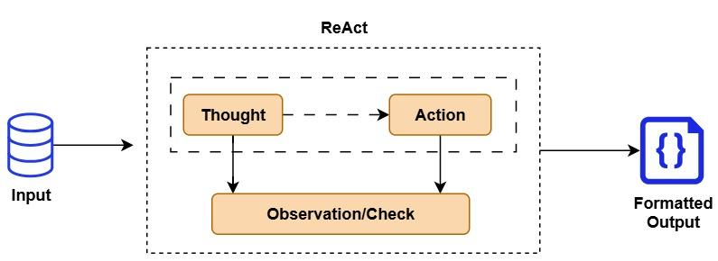
Approach 2: ReAct Framework
Reasoning and Acting Paradigm
Iterative Cycle:
Thought: Analyzes physician's turns to detect orders
Action: Generates candidate extractions
Observation: Validates, enforces constraints, repeats
Goal: Improve accuracy through explicit reasoning

Slide 9
Approach 3: Agentic Workflow
Multi-Agent Pipeline
Agent 1: Identifier - Scans transcript, outputs raw list
Agent 2: Mapper - Creates pairings between orders and reasons
Agent 3: Structurer - Formats into final JSON structure
Agent 4: Validator - Final check to correct errors

Slide 10
Evaluation Metrics
ROUGE-1 F1
For descriptions/reasons
Unigram-level overlap
Strict F1
For order type
Exact match only
Multi-Label F1
For provenance
Multiple sources
Average Score
Overall performance
Balanced assessment

Slide 11
Results: MedGemma-4B (Dev Set)
Approach | Description | Reason | Order Type | Provenance | Avg Score
1-Shot | 0.516 | 0.318 | 0.602 | 0.307 | 0.436
ReAct | 0.363 | 0.120 | 0.465 | 0.160 | 0.277
Agentic | 0.090 | 0.060 | 0.169 | 0.123 | 0.111
1-Shot achieved highest performance

Slide 12
Results: MedGemma-27B (Test Set)
Approach | Description | Reason | Order Type | Provenance | Avg Score
1-Shot | 0.591 | 0.342 | 0.703 | 0.561 | 0.549
ReAct | 0.353 | 0.283 | 0.497 | 0.350 | 0.370
Key Finding: Larger model (27B) improved all scores substantially
Consistent Pattern: 1-Shot remained superior to ReAct
Competition Result: Fourth place in MEDIQA-OE 2025 shared task

Slide 13
Key Finding: Analytical Over-Processing
Counterintuitive Result
Increased complexity in prompting did NOT translate to improved performance
Why Complex Approaches Failed:
Spurious reasoning steps introduced errors
Fabricated relationships between dialogue elements
Misinterpreted clinical nuances
Clean data with well-defined ground truth - additional layers added noise
1-Shot Advantages:
More direct and constrained generation
Less susceptible to systematic errors
Computationally efficient
Implementation simplicity

Slide 14
Limitations
Dataset Dependency
Our conclusion is heavily dependent on MEDIQA-OE dataset. In real-world clinical settings with noisy ASR transcripts, ReAct/Agentic might outperform 1-Shot
Implementation Constraints
Agentic workflow implemented within single model, not true multi-agent system. Larger models make Agentic approach computationally expensive
Model Size Issues
Smaller models (4B) showed hallucinations and tendency to replicate examples rather than extract new information
Annotation Quality
Sparse and inconsistent annotations, inter-annotator variability, non-standardized labels, class imbalance

Slide 15
Conclusion & Key Takeaways
Main Findings
For manually annotated clinical transcripts, simple 1-Shot prompting is surprisingly effective
Complex reasoning frameworks prone to overthinking and introducing errors
Domain-specific models (MedGemma) significantly outperform base models
Achieved 4th place in MEDIQA-OE 2025 shared task
Critical Lesson for Applied NLP
The optimal solution is a function of not just the model's power, but also the characteristics of the data
Future Work
Explore these prompting paradigms on noisier, real-world clinical data to determine if complex reasoning frameworks become more beneficial

Slide 16
Thank You
Questions?
EXL Health AI Lab
MEDIQA-OE 2025 Shared Task
Prompts and code available in Git repository

